Slide 1
An Electronic Voting Machine
Based on 8085 Microprocessor

Slide 2
An Overview of The Problem

Slide 3
The Problem
Design a microprocessor Voting Machine which has provision for 8 candidates.
Clear the count before starting
It needs to be enabled by 8 polling agents and the Presiding officer.
After 10 hours (7 a.m. to 5 p.m.) it should stop taking input
The Presiding officer by pressing a code can lock it in between & then can restart it by pressing another code.

Slide 4
Components to be used
8085 - Microprocessor
8255-Programmable peripheral interface x2
8254 -Timer IC
7400 -NAND
7402- NOR
Resistors
Switches
74147 - Priority Encoder

Slide 5
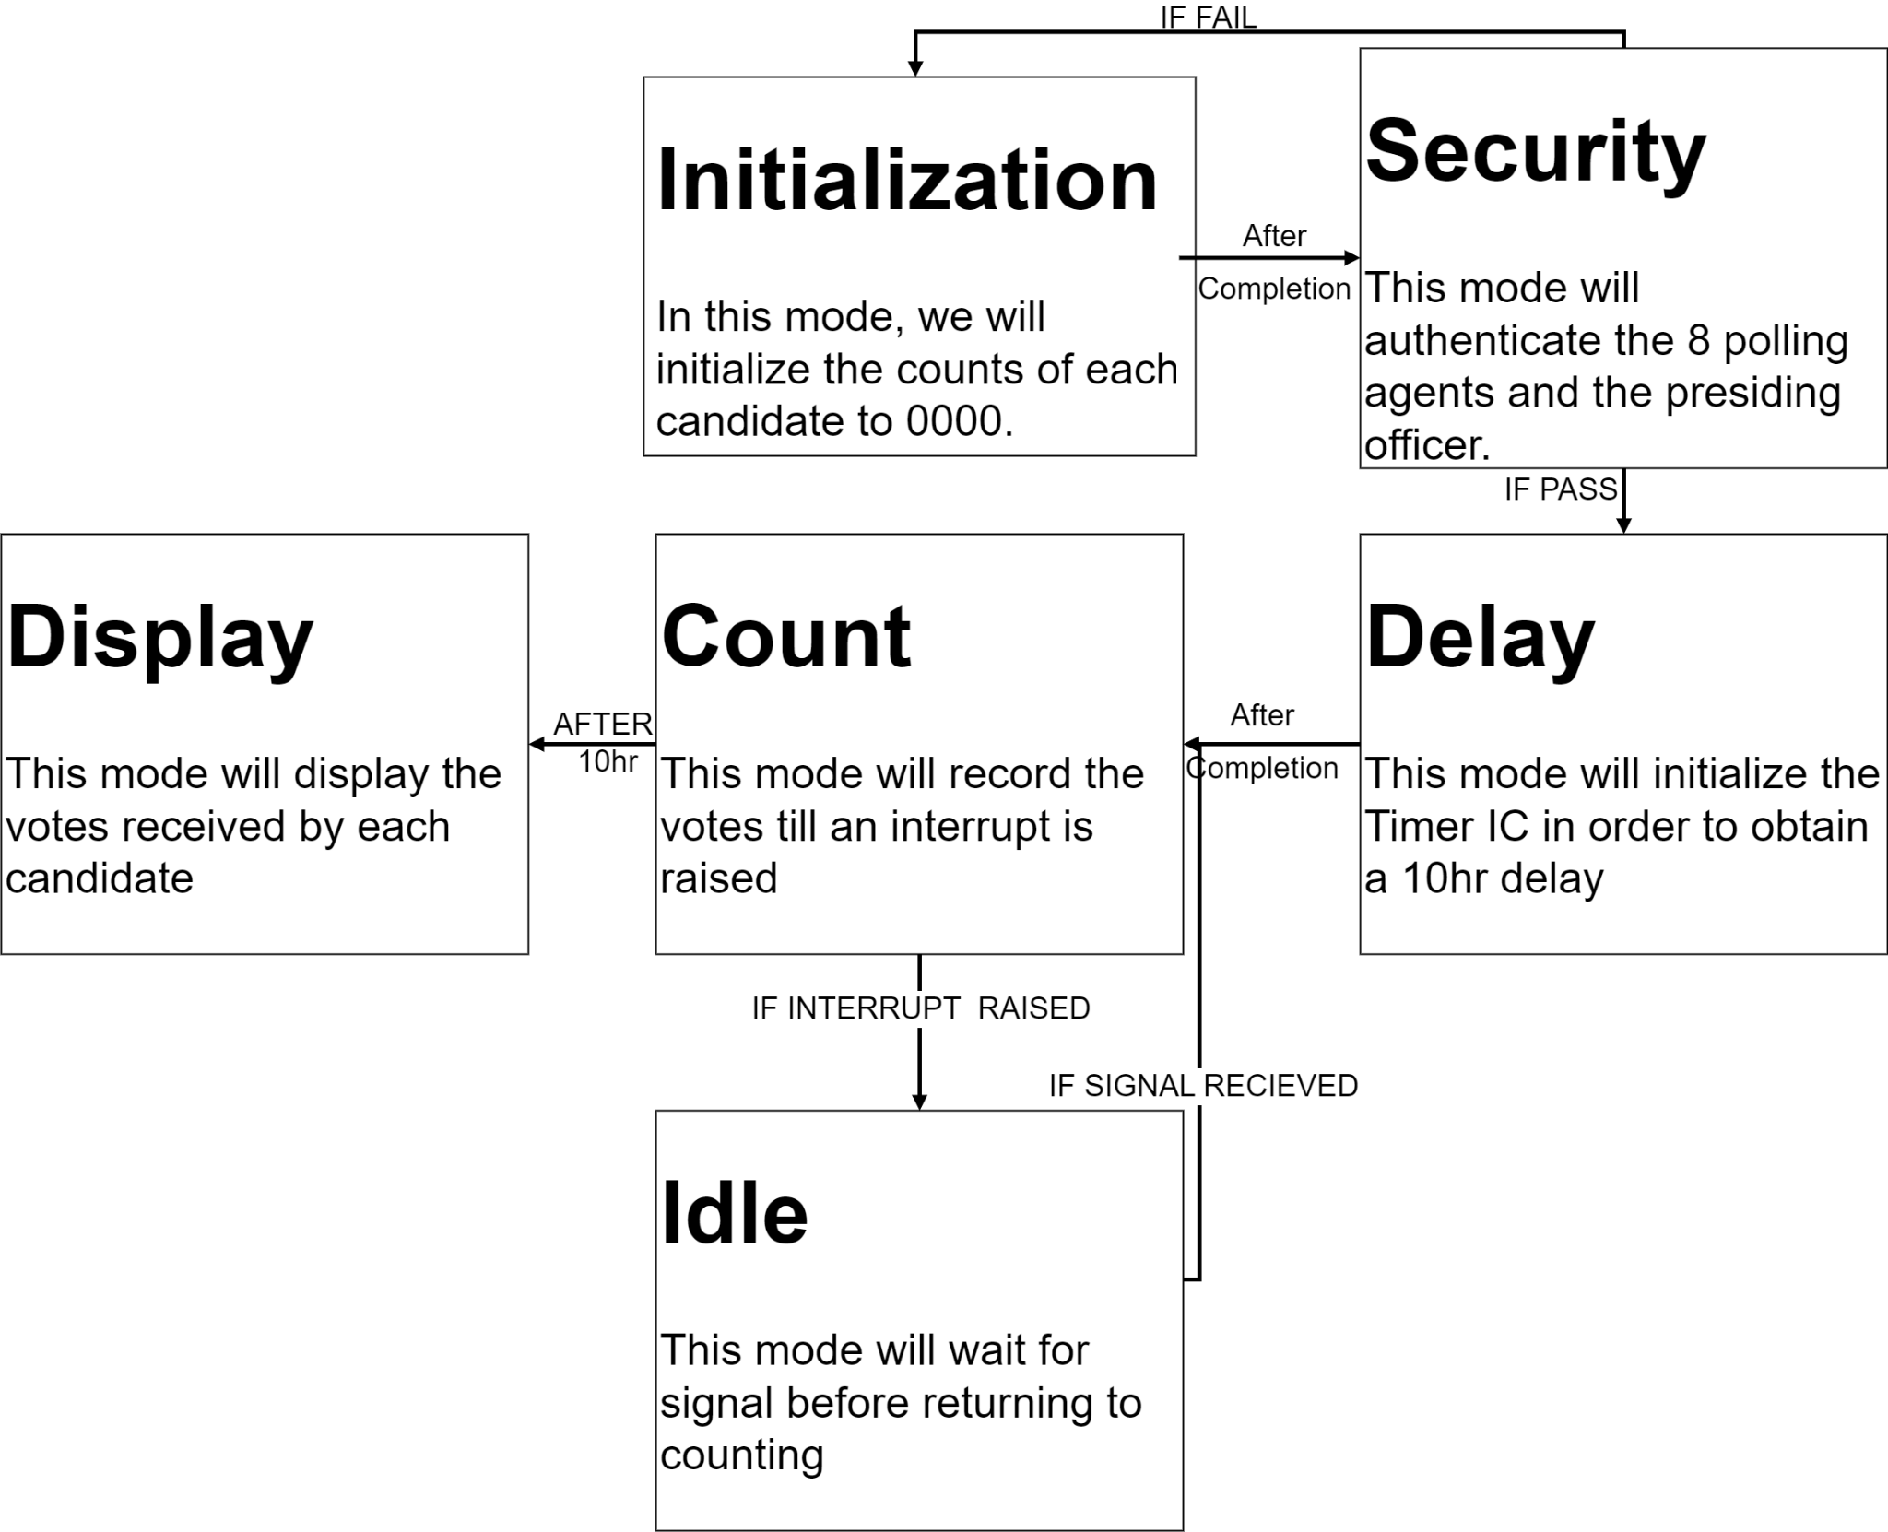

Slide 6
I/O Interfacing Table

Slide 7
Sr No. | Type of IC | Port Address |  | Binary
1 | 8255 | Label | Hex | B7 | B6 | B5 | B4 | B3 | B2 | B1 | B0
 |  | A | 0x00 | 0 | 0 | 0 | 0 | 0 | 0 | 0 | 0
 |  | B | 0x01 | 0 | 0 | 0 | 0 | 0 | 0 | 0 | 1
 |  | C | 0x02 | 0 | 0 | 0 | 0 | 0 | 0 | 1 | 0
 |  | CWR | 0x03 | 0 | 0 | 0 | 0 | 0 | 0 | 1 | 1
2 | 8255 | A | 0x04 | 0 | 0 | 0 | 0 | 0 | 1 | 0 | 0
 |  | B | 0x05 | 0 | 0 | 0 | 0 | 0 | 1 | 0 | 1
 |  | C | 0x06 | 0 | 0 | 0 | 0 | 0 | 1 | 1 | 0
 |  | CWR | 0x07 | 0 | 0 | 0 | 0 | 0 | 1 | 1 | 1
3 | 8254 | C0 | 0x08 | 0 | 0 | 0 | 0 | 1 | 0 | 0 | 0
 |  | C1 | 0x09 | 0 | 0 | 0 | 0 | 1 | 0 | 0 | 1
 |  | C2 | 0x0A | 0 | 0 | 0 | 0 | 1 | 0 | 1 | 0
 |  | CWR | 0x0B | 0 | 0 | 0 | 0 | 1 | 0 | 1 | 1

Slide 8
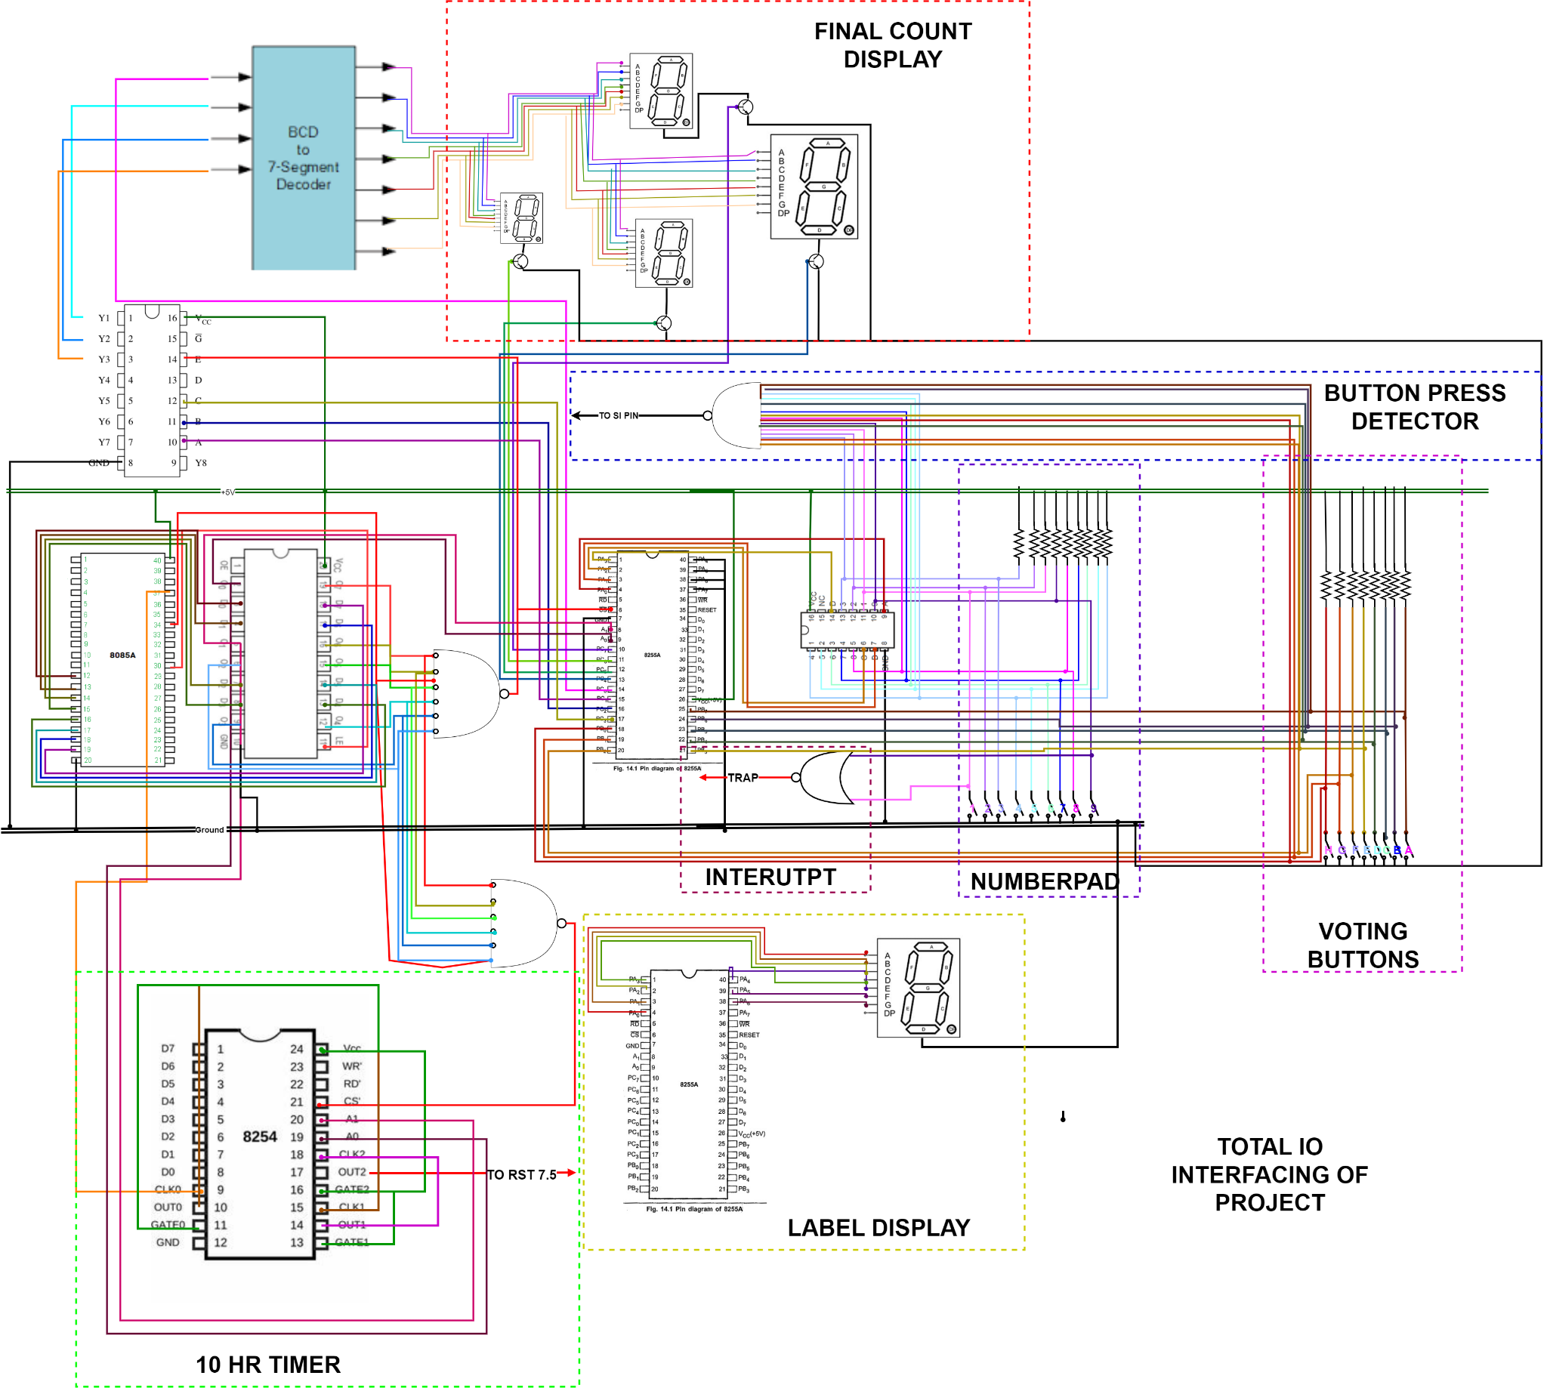

Slide 9
Initialization

Slide 10
How Data of Votes will Be Stored
Mem Ad | Data | Mem Ad | Data | Mem Ad | Data | Mem Ad | Data
1000 | “A” | 1006 | “C” | 100C | “E” | 1012 | “G”
1001 | LSB | 1007 | LSB | 100D | LSB | 1013 | LSB
1002 | MSB | 1008 | MSB | 100E | MSB | 1014 | MSB
1003 | “B” | 1009 | “D” | 100F | “F” | 1015 | “H”
1004 | LSB | 100A | LSB | 1010 | LSB | 1016 | LSB
1005 | MSB | 100B | MSB | 1011 | MSB | 1017 | MSB

Slide 11
Approach
Initially,
All bit must be 00
Labels for candidates to be set alphabetically
This initialization subroutine should be called on powering on the machine. So, it is written at 0x000

Slide 12
Program

Slide 13
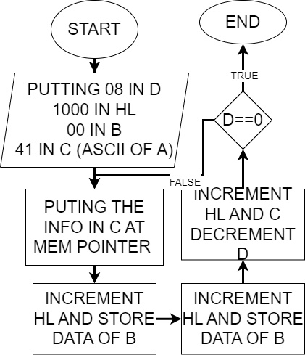

Slide 14
Code
Start:MVI A,92
OUT 03
MVI A,80
OUT 07
MVI D,08
MVI A,1B
SIM
LXI H,1000
MVI B,00
MVI C,41
loop_init:MOV M,C
INX H
MOV M,B
INX H
MOV M,B
INR C
DCR D
JNZ loop_init
CALL security:

Slide 15
Counting The Votes

Slide 16
Approach
According to the Election commission of India, a EVM is expected to count a maximum of 3840 votes, So we are required to build a 16 bit counter.
We will interface 8 buttons to port b of 8255

Slide 17
Interfacing Diagram

Slide 18
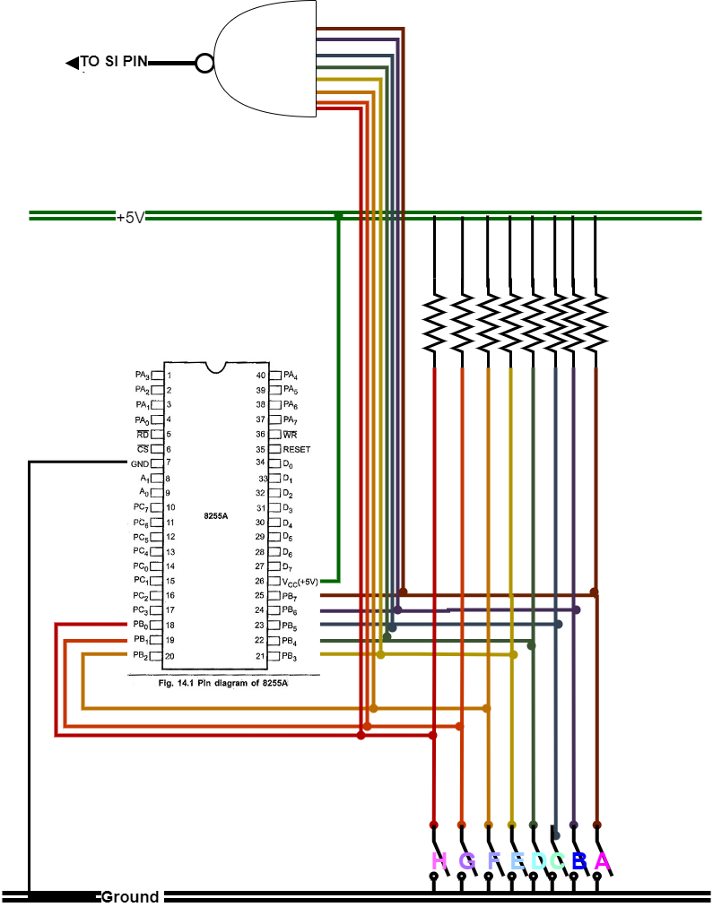

Slide 19
Components used
8255-Programmable peripheral interface
7400-NAND gate
Resistors
Switches
Connecting wire

Slide 20
Program

Slide 21
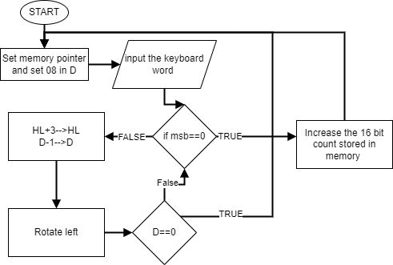

Slide 22
Program
count:LXI H,1000
LDA 1023
OUT 04
wait3:RIM
JP wait3
IN 01
MVI D,08
loop_rot:ORI 00
CP cntup
INX H
INX H
INX H
RLC
DCR D
JNZ loop_rot
JMP count
cntup:INX H
MOV C,M
INX H
MOV B,M
INX B
MOV M,B
DCX H
MOV M,C
JMP count

Slide 23
Security Procedures

Slide 24
Basic Appraoch
Interface a number pad to the 8085 via a 8255.
8-bit security codes stored in the memory.
All 9 codes need to be entered one after another correctly to authenticate.

Slide 25
How Data will be stored in memory
Memory Address | Data | Memory Address | Data | Memory Address | Data
0x1018 | Code 1 | 0x101B | Code 4 | 0x101E | Code 7
0x1019 | Code 2 | 0x101C | Code 5 | 0x101F | Code 8
0x101A | Code 3 | 0x101D | Code 6 | 0x1020 | Code 9

Slide 26
Interfacing Diagram

Slide 27
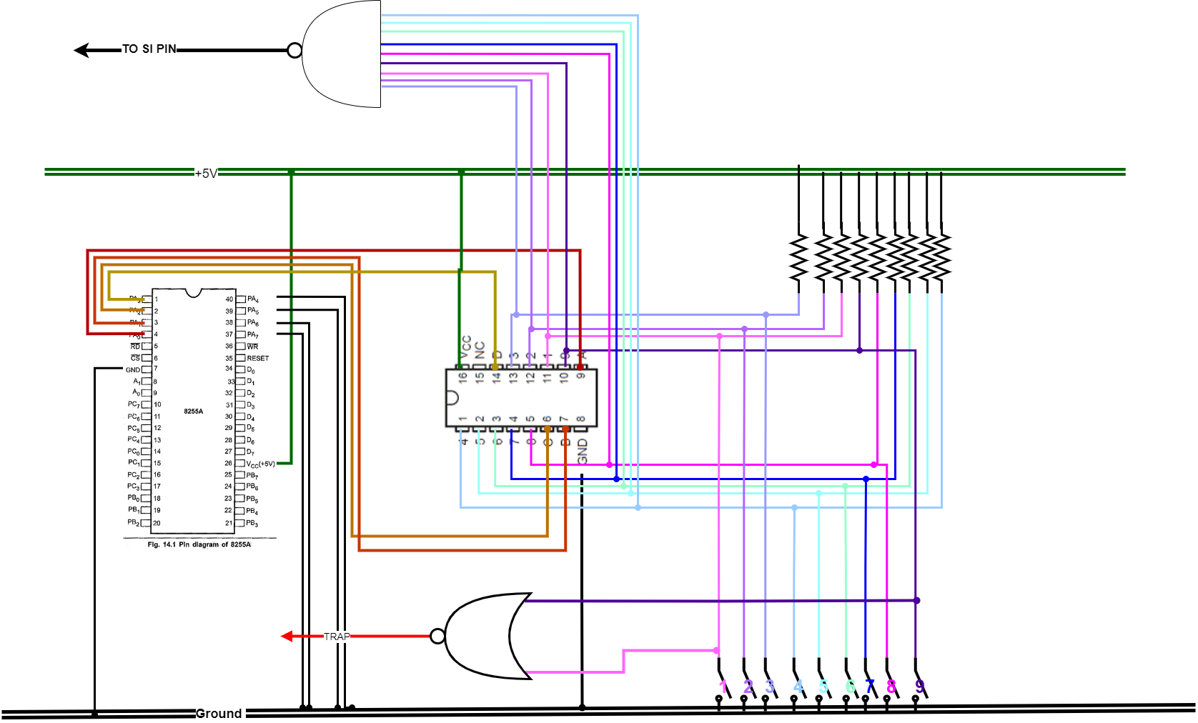

Slide 28
Components used
8255-Programmable peripheral interface
74147 -Priority Encoder
7402-NOR gate
7400-NAND gate
Resistors
Switches
Connecting wire

Slide 29
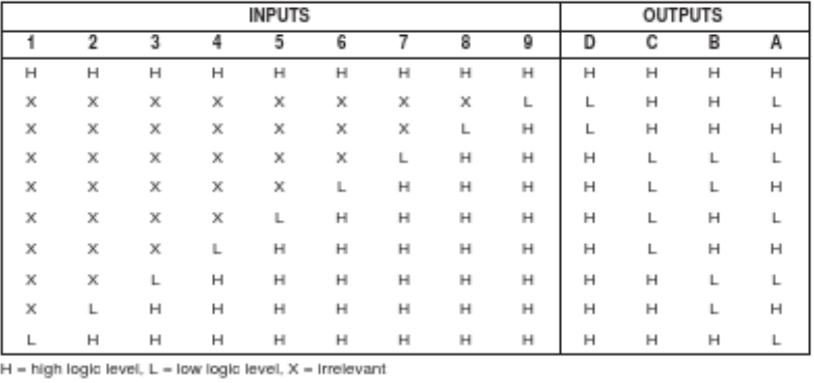
Truth Table of Priority Encoder

Slide 30
Program

Slide 31
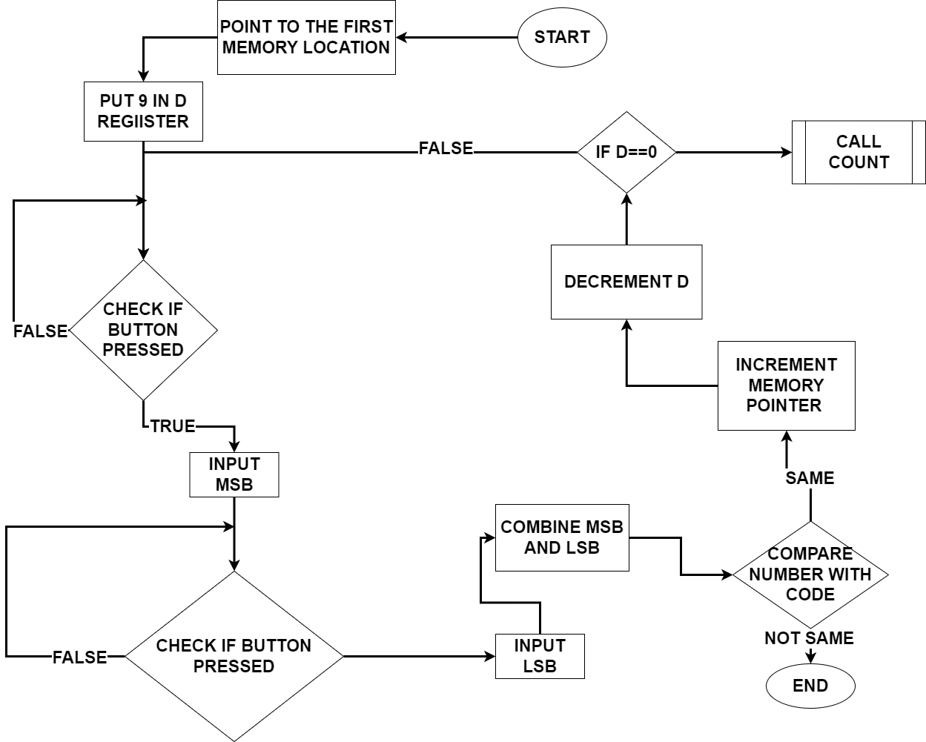

Slide 32
Code
security:LXI H,1018
LDA 1029
OUT 04
wait1:RIM
JP wait1
IN 00
RLC
RLC
RLC
RLC
MOV B,A
wait2:RIM
JP wait2
IN 00
ADD B
CMA
CMP M
RNZ
INX H
DCR D
JNZ wait1
JMP Delay

Slide 33
Creating The 10 hr Delay

Slide 34
Basic Approach
Perform frequency division using IC-8254, to make the time period of the clock 1,000s
Then use a counter of 36 to make delay of 10hr
After this, An RST7.5 is given and the display routine is written there

Slide 35
Interfacing Diagram

Slide 36
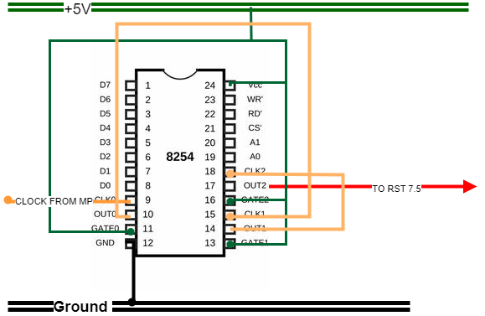

Slide 37
Program

Slide 38
Code
delay:mvi a, 36
out 0B
mvi a, ff
out 08
mvi a,ff
out 08
mvi a, 76
out 0B
mvi a, B2
out 09
mvi a, C4
out 09
mvi a,B1
out 0B
mvi a, 36
out 0A
mvi a, 00
out 0A
jmp count

Slide 39
Displaying The Count

Slide 40
Appraoch
Interfacing 5 seven segment displays,
4 displays would display the count
1 will act as the label for the candidates and the different modes
Interfacing 4 seven segment via the c port of the 8255
Interfacing the label seven segment via port a of another 8255
The routine would be written at RST7.5 location

Slide 41
Look up table for labels
Mem Ad | Label | Data | Mem Ad | Label | Data
0x1021 | A | EE | 0x1026 | F | 8E
0x1022 | b | 2E | 0x1027 | g | F6
0x1023 | C | 9C | 0x1028 | H | 6E
0x1024 | d | 7A | 0x1029 | S | B6
0x1025 | E | 9E

Slide 42
Interfacing Diagram

Slide 43
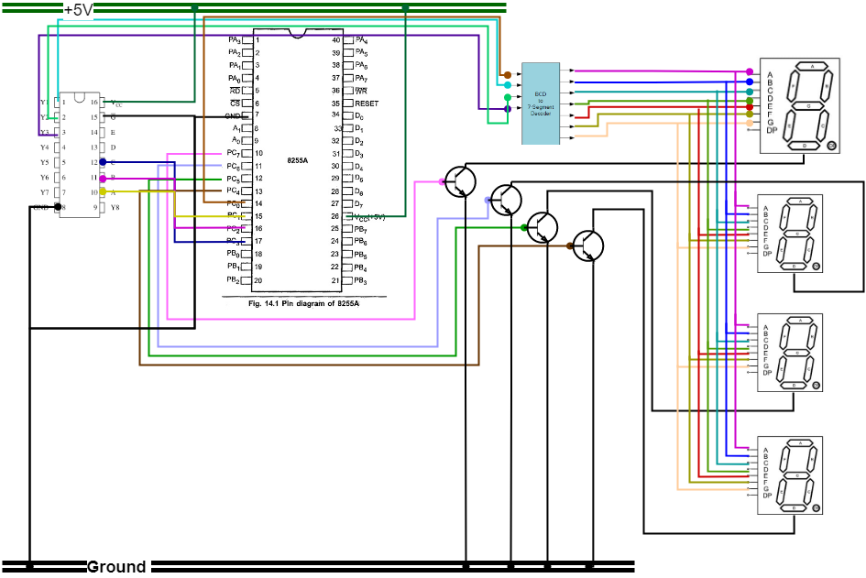

Slide 44
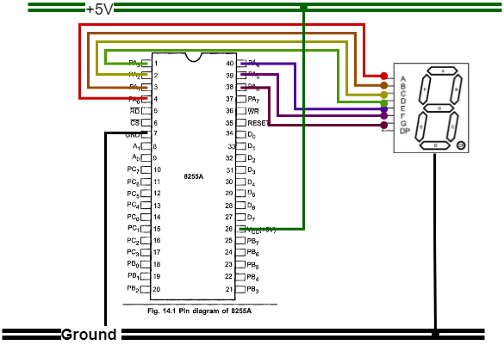

Slide 45
Program

Slide 46
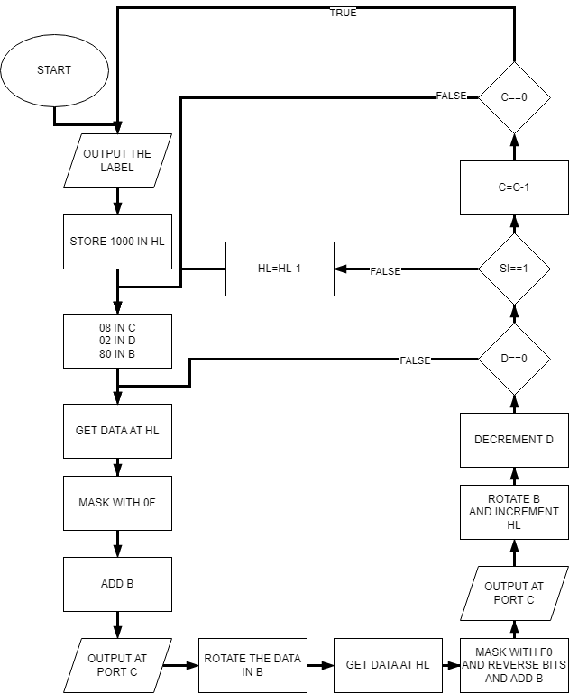

Slide 47
Code
XCHG
DCR C
JNZ REP
JMP REP1
REPEAT:DCX H
JMP REP
LOOP1:MOV A,M
ANI 0F
ADD B
OUT 02
MOV A,B
RRC
MOV B,A
MOV A,M
ANI F0
RRC
DCR D
JNZ LOOP1
RIM
CP REPEAT
INX H
XCHG
POP H
INX H
OUT Pa2
PUSH H
RRC
RRC
RRC
ADD B
OUT 02
MOV A,B
RRC
MOV B,A
INX H
REP1:LXI H,1021
MOV A,M
OUT 04
PUSH H
LXI H,1001
REP:MVI C,08
MVI D,02
MVI B,80

Slide 48
Emergency Interrupt

Slide 49
Approach
If the presiding officer presses 19 simultaneously the counting will be halted
Untill, he presses 37 keys

Slide 50
Program

Slide 51
Code
trap:RIM
JP wait1
IN 00
RLC
RLC
RLC
RLC
MOV B,A
wait2:RIM
JP wait2
IN 00
ADD B
CMA
CPI 37
JNZ trap
JMP count

Slide 52
More Info for Refrence

Slide 53
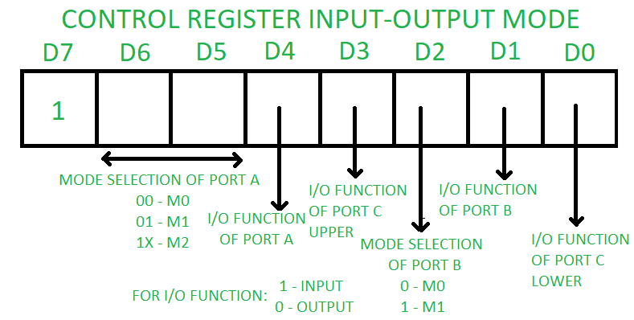
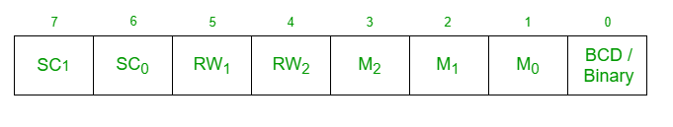
CWR OF 8255 and 8254

Slide 54
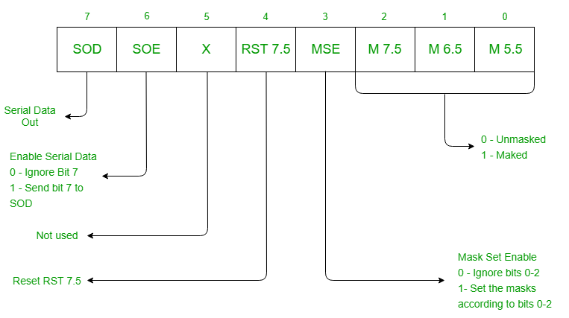
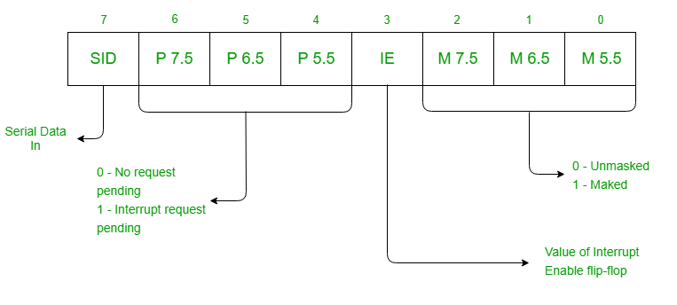
Format of RIM and SIM

Slide 55
Click on the github link for access to code and other information
https://github.com/AnshumatDinesh/An-Electronic-Voting-Machine-Using-8085-Microprocessor

